Slide 1

Genomic Scholars Program
Day 1 – Exercises
Introduction to Genome Browsers
09/08/2023
Revathy Venukuttan
Notes:
Good afternoon everyone,
First of all, thank you Dr. Olabaisi for that wonderful talk.
A quick introduction – I am Revathy Venukuttan, a bioinformatician working at the Duke center for combinatorial gene regulation.
I’ll be leading this first hands-on session for the workshop series which is Introduction to Genome Browsers

Slide 2
What are Genome Browsers?
Graphical interface for users to browse, search, retrieve and analyze genomic data
Data include variation, transcription, regulatory data such as methylation, transcription factor binding and disease associations
Some of the larger genome browsers also serves as data archives for public datasets
It is also possible to load your own data into some of the public genome browsers
Some of the genome browsers commonly used are:
Integrative Genome Viewer (IGV)
The UCSC Genome Browser
ENSEMBL Genome Browser
NCBI Genome Data Viewer
Notes:
So, what are genome browsers?
These are graphical interfaces wich allows users to browse, visualize, analyze and retrieve genomic data.
Different types of data can be visualized like variation, transcription, regulation, disease association etc.
There are a lot of genome browsers/viewers that exist today and some of them can even serve as data archives for public datasets
It is also possible to load our own data into these browses – which we will be exploring today.
Some of the commomnly used browsers are IGV, UCSS , ENSEMBL and NCBI. We will be focusing more on IGV today and if time permits briefly touching upon UCSC

Slide 3
What are Genome Browsers?
ENSEMBL Genome Browser was developed as part of the Human Genome Project to provide a complete resource for the human genome sequence with focus on annotation
NCBI Genome Data Viewer (GDV) supports the exploration and analysis of annotated eukaryotic genome assemblies. The browser displays biological information mapped to a genome including gene annotation, variation data, BLAST alignments and experimental data from NCBI GEO and dbGap databases.
There are many common functionalities across all these browsers, and users can explore the capabilities of each browser to determine the one they prefer.
Notes:
Brief description of ENSEMBL Genome Browser – this is one of the first browsers that was developed during the human genome project with a focus on annotation while NCBI data viewer supports exploration and analysis eukaryotic genome assemblies.
If we try to compare and contrast the available genome browsers, it can be observed that most of them have a lot of common functionalities, which means users like us can explore their capabilities and then decide which perfectly fits our need. For eg: UCSC is good when you want to compare your data against public benchmarked data (like annotations/variations) or it can be used to download annotation files or genomic sequences but if your aim is to visualize your experimental data, I would go for IGV since its faster, simple and clutter free.
With that, lets dive more into what IGV is

Slide 4
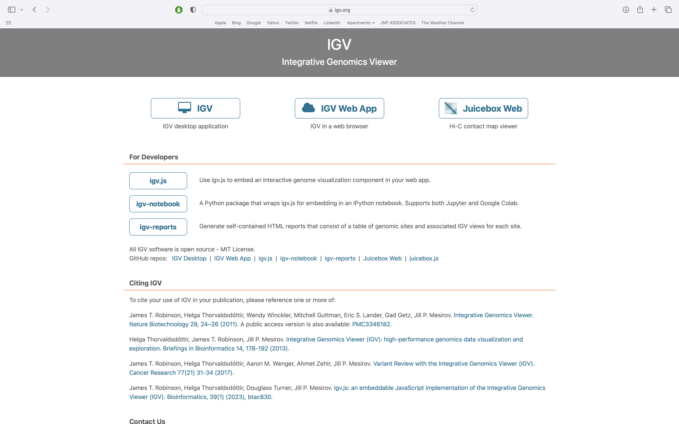
IGV (Integrative Genome Viewer)
High-performance, easy to use, interactive tools for visual exploration of genomic data
Web app, desktop application and there is a Javascript component (igv.js) available in: https://igv.org/
Landing page of IGV.org
Notes:
IGV stands for Integrative Genome Viewer. It’s a high performance, easy-to-use interactive tools for visually exploring genomic data. There is a web app desktop app and a java script verion available for IGV.
This is the landing page for IGV.org where you can select which option you need

Slide 5
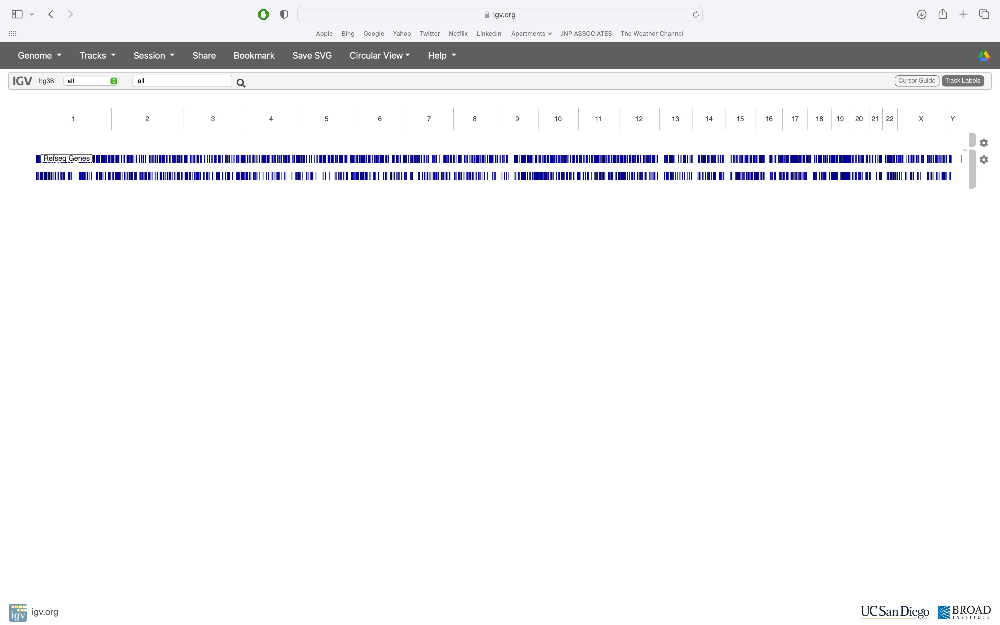
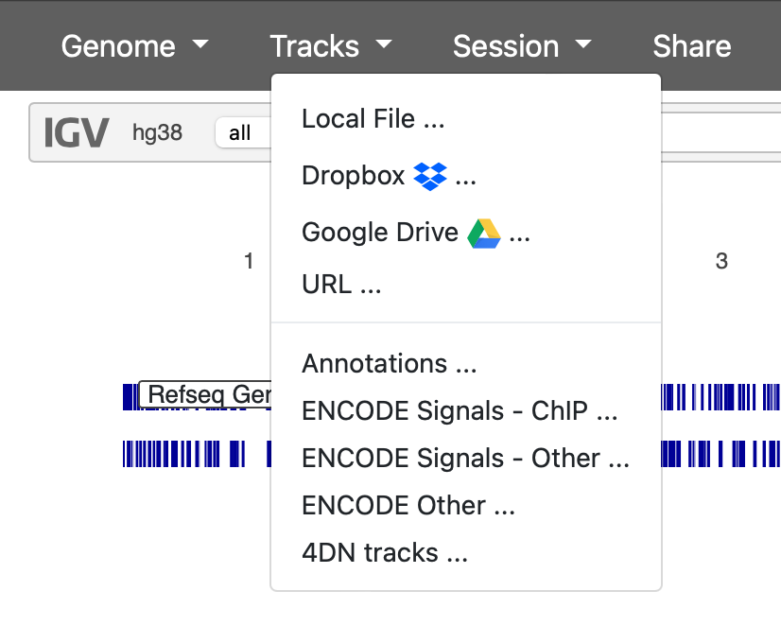
IGV Web App Landing page
Genome build
Tracks can be loaded from local, drive, dropbox or using URL
Chromosomes
Refseq genes
Notes:
This is how the webapp landing page looks

Slide 6
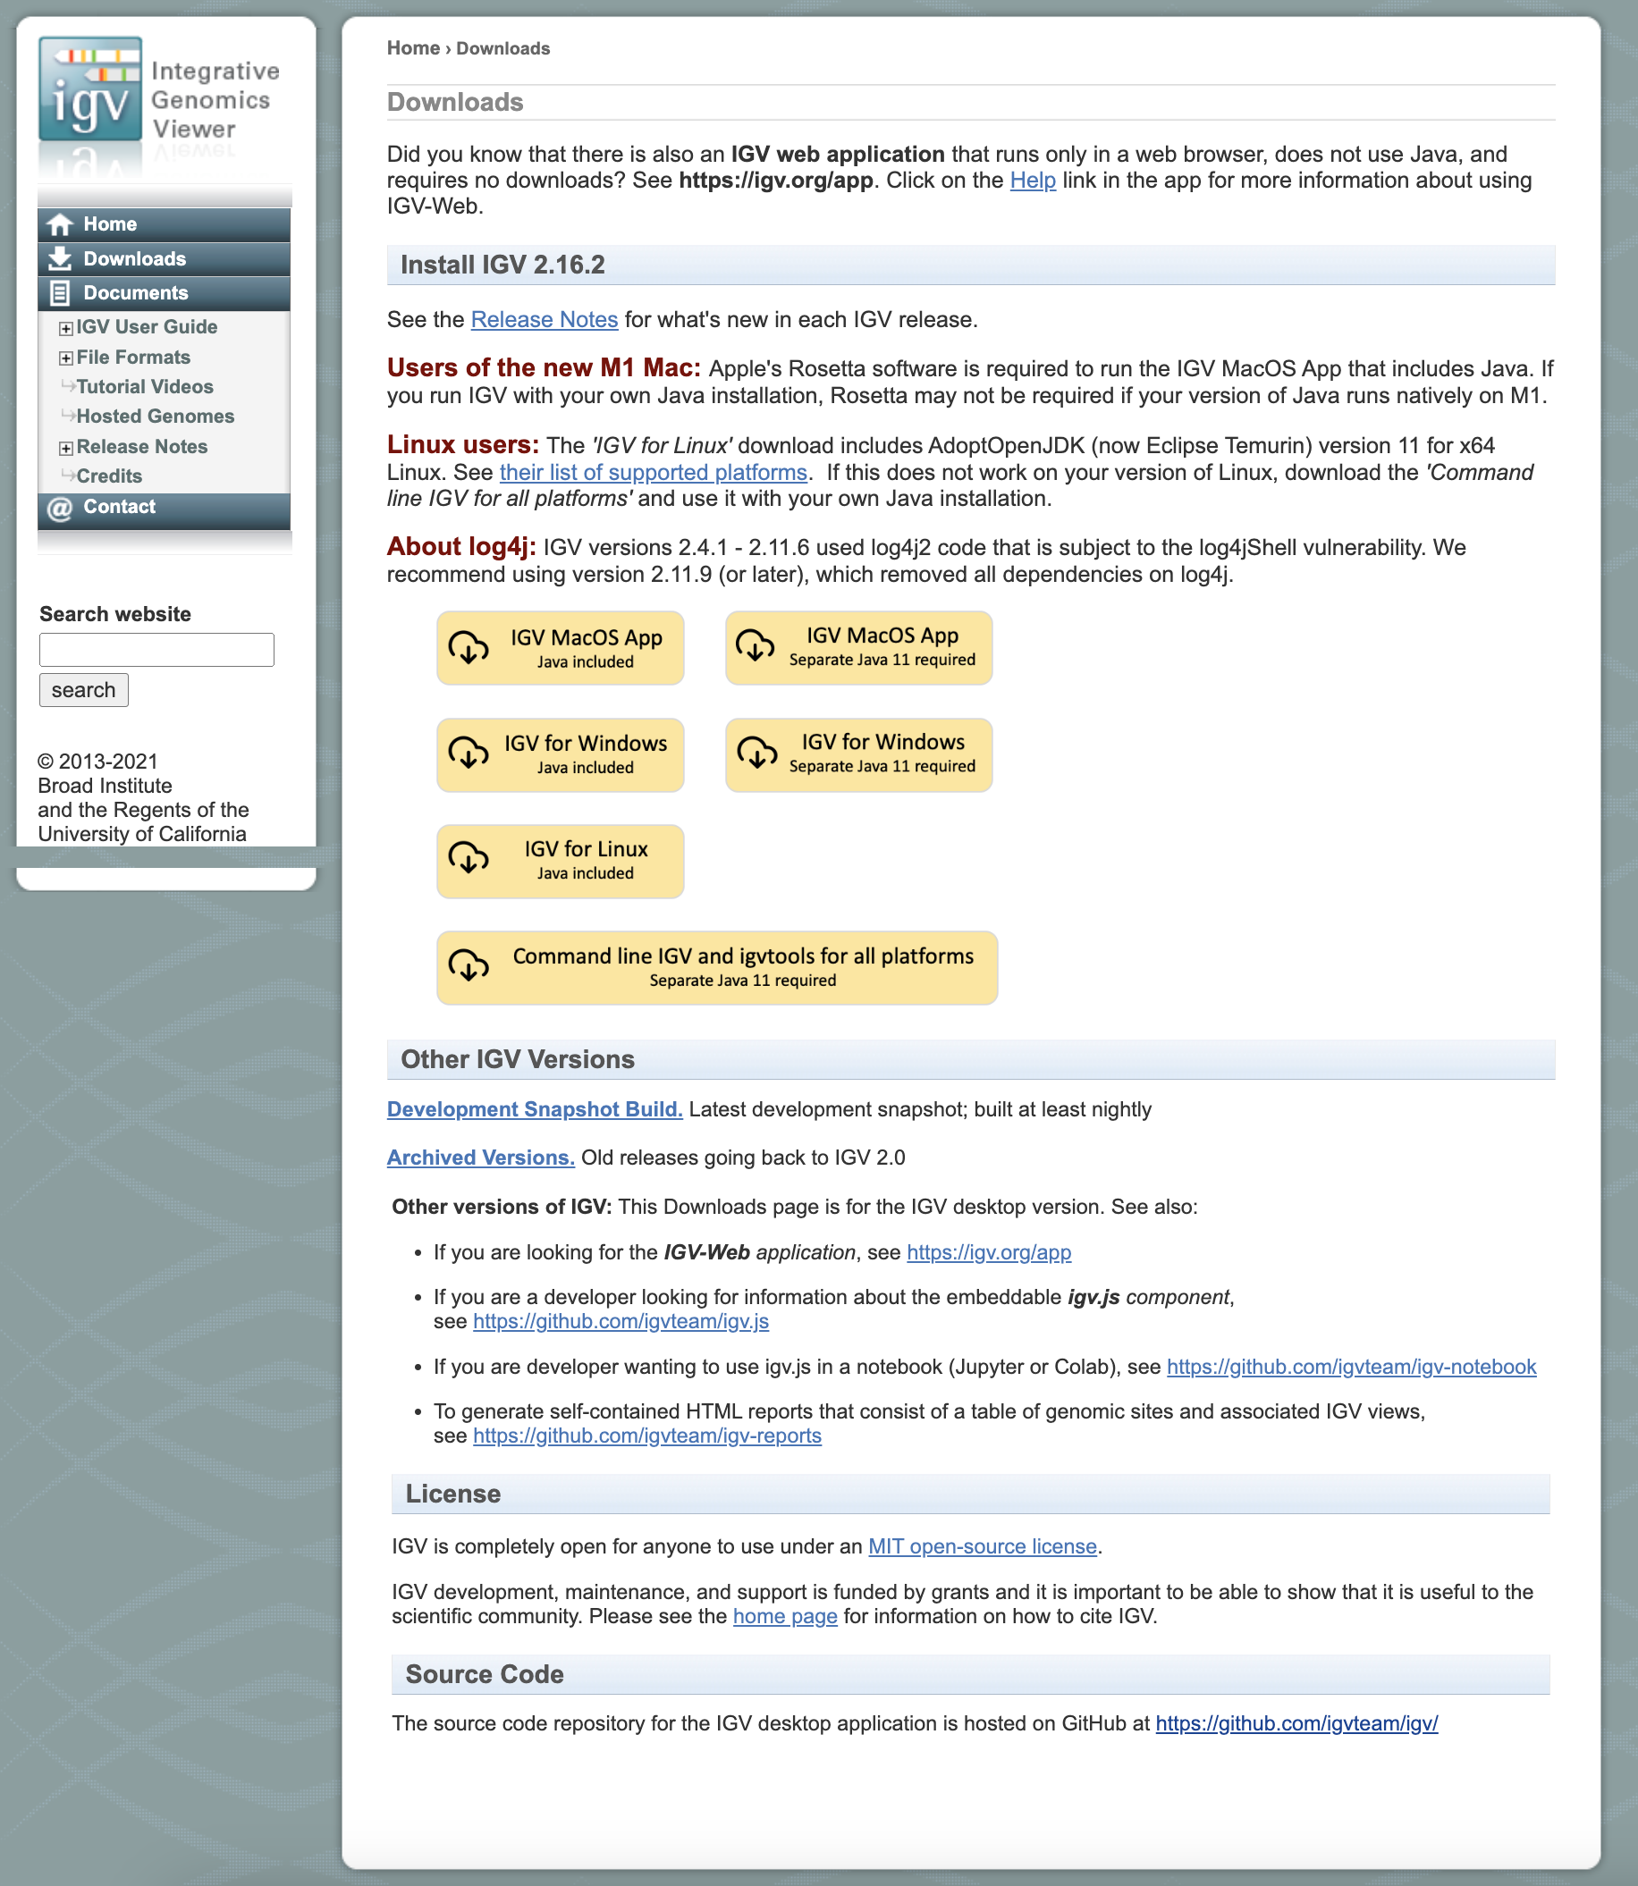
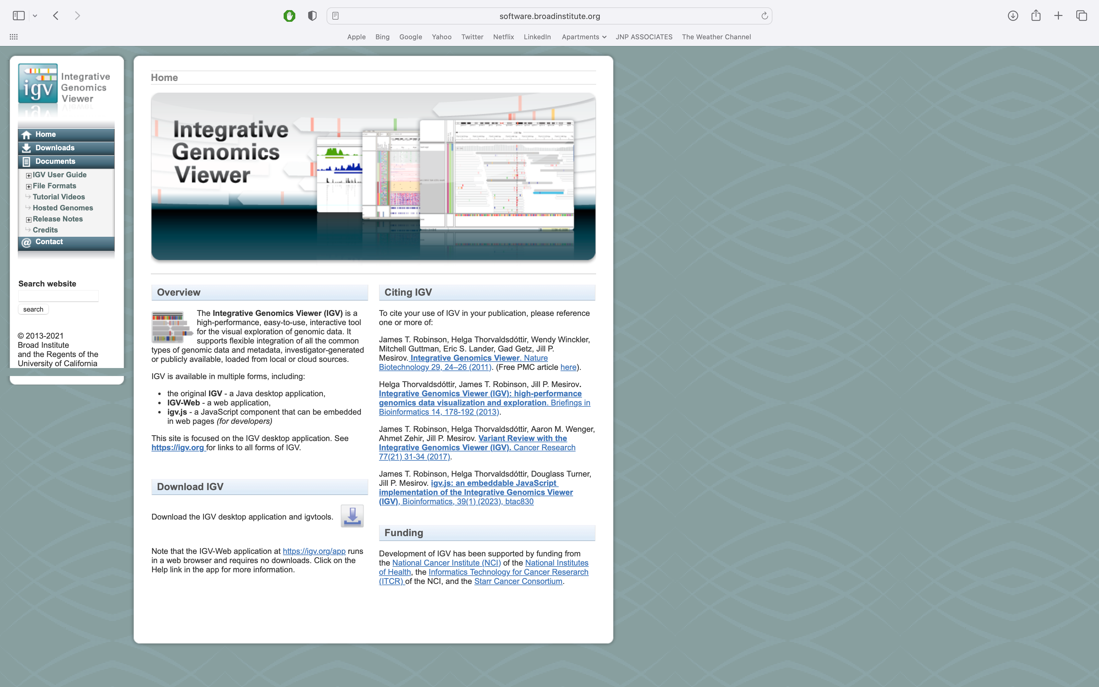
IGV Desktop Application:
The right installation for your system can be downloaded from here:
Notes:
So, for this workshop series, we will be using the desktop application. Hope all of you have IGV downloaded and installed in your laptop

Slide 7
Exercise 1 – Familiarize IGV
Get familiar with the IGV UI
Load data into IGV – different ways
Navigate through available options to view data
Notes:
So, Starting with exercise 1 – familiar with the IGV UI, learn how to load data into IGV and then to navigate through data, play a little bit all of the viewing and menu options available

Slide 8
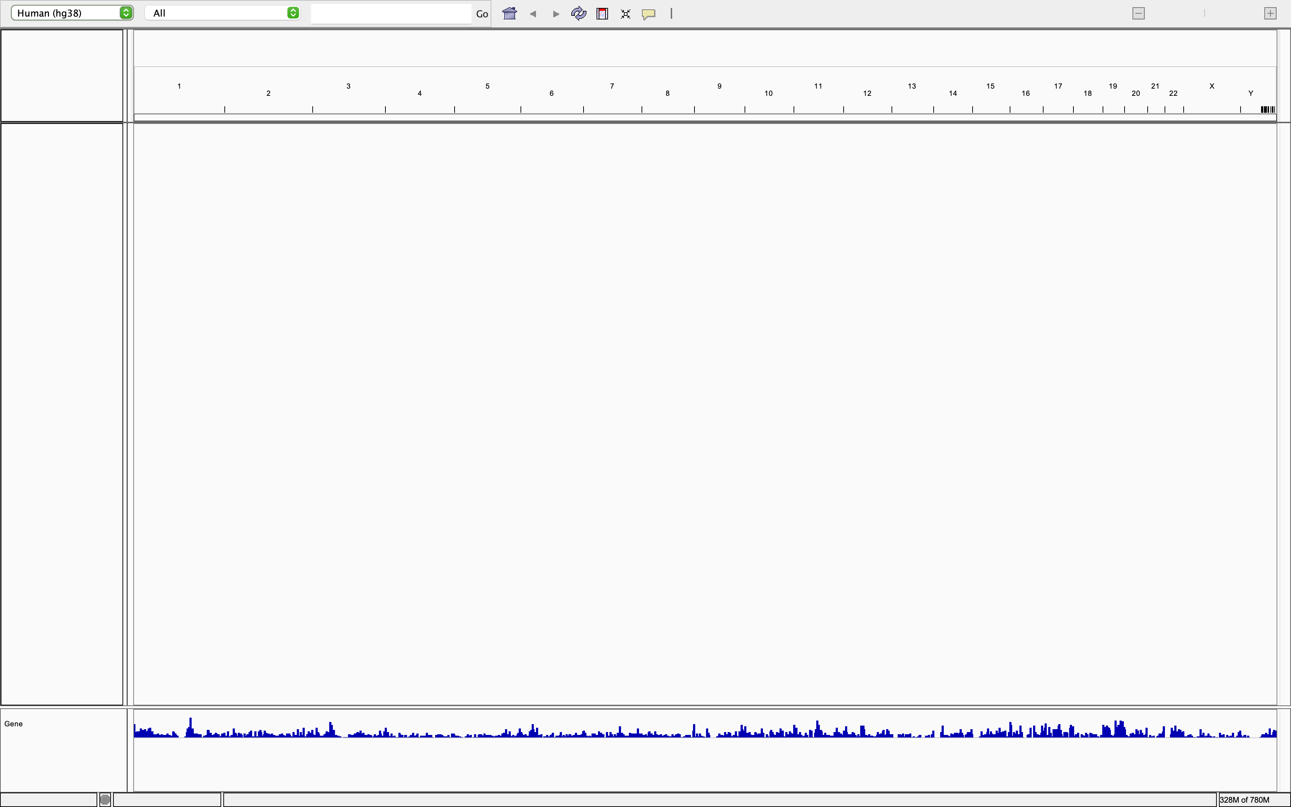
1. Launch IGV
Landing page of IGV
Genome build
Chromosomes
<Load tracks here>
Refseq genes
Notes:
Landing page

Slide 9
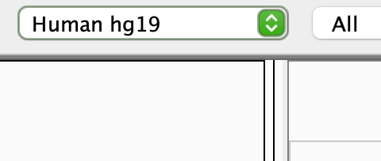
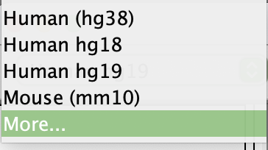
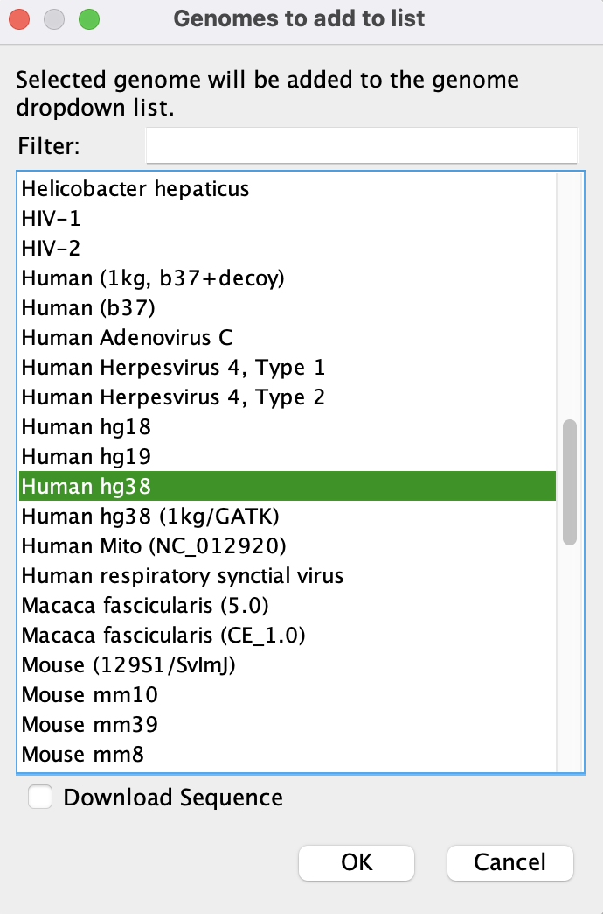
2. Select reference genome
If you are using IGV for the first time, you might not see any other genome in the drop-down menu
Selecting “More…” will open a new window with other options of Genome build that could be added to IGV.
There is an option to download the entire sequence for the selected genome

Slide 10
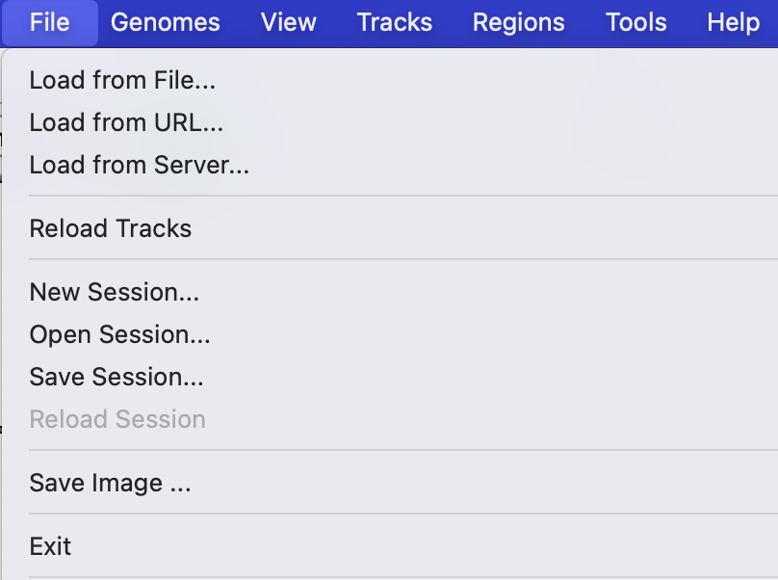
2. Select reference genome
2. Load data
Different visualization files (.bam, .bw, .bedGraph, .bed) can be loaded on to IGV from tool bar
If you are using IGV for the first time, you might not see any other genome in the drop-down menu
Tracks can be loaded into IGV from:
File – local machine
URL – From a HTTP or an FTP URL associated with the data file. Eg: Google cloud storage where the path to the file looks like: gs://genomics-public-data/platinum-genomes/bam/NA12877_S1.bam
Server – From IGV Data Server – Datasets from various public databases (TCGA, 1000Genomes, Annotations) can be loaded directly into IGV
Alternatively, data can also be loaded from a saved IGV session
Selecting “More…” will open a new window with other options of Genome build that could be added to IGV.
There is an option to download the entire sequence for the selected genome

Slide 11
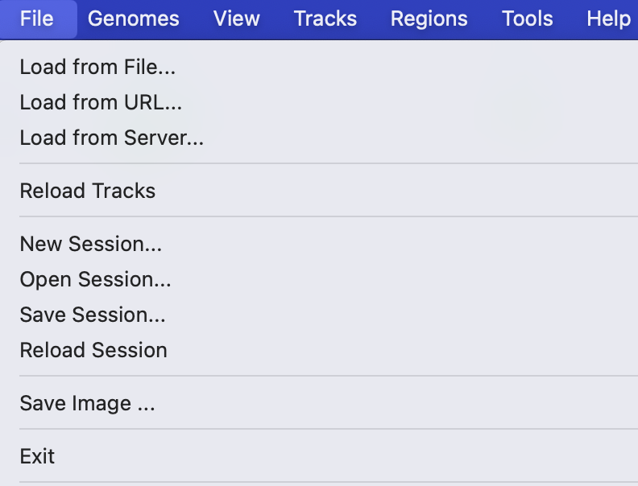
2. Load data (From saved session)
Download the Github .zip folder and make sure the Day1 folder is in there
Let’s load a saved IGV session by File -> Open Session -> ~/Day1/igv_session_1.xml

Slide 12
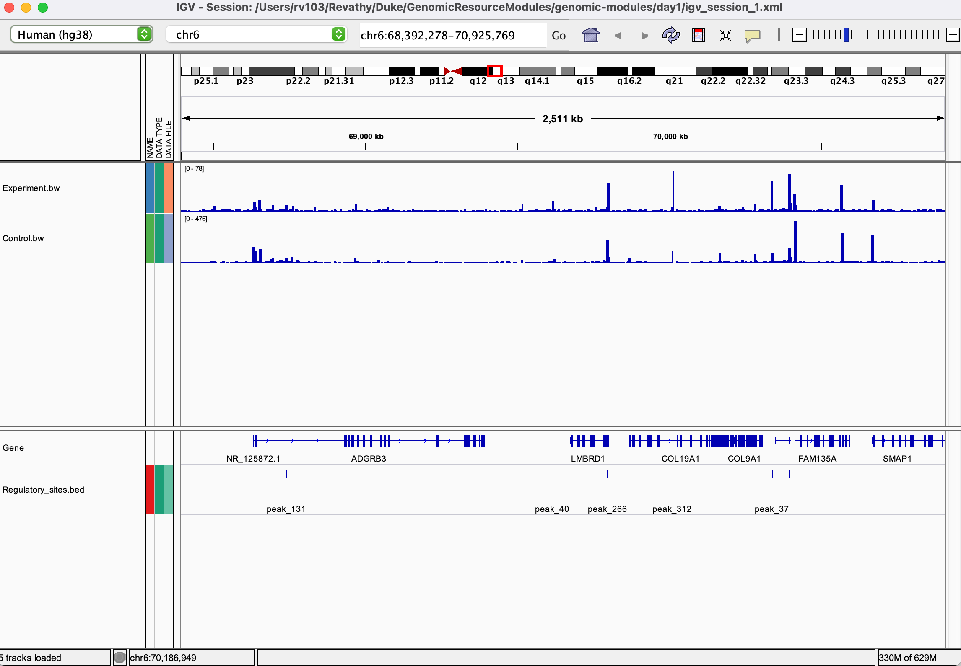
2. Load data (From saved session)
Download the Github .zip folder and make sure the Day1 folder is in there
Let’s load a saved IGV session by File -> Open Session -> ~/Day1/igv_session_1.xml

Slide 13
Navigating the IGV UI
1. Tool Bar
a. Select genome build
This drop-down menu can be used to select genome build of interest from the available list
Notes:
Top left – drop down menu to select genome build

Slide 14
Navigating the IGV UI
1. Tool Bar
b. Select chromosome
a. Select genome build
This drop-down menu can be used to select genome build of interest from the available list
This enables user to select specific chromosome to zoom in to

Slide 15
Navigating the IGV UI
1. Tool Bar
b. Select chromosome
c. Select region/loci/gene
a. Select genome build
This drop-down menu can be used to select genome build of interest from the available list
This enables user to select specific chromosome to zoom in to
Specific regions/gene name can be typed in here to view them

Slide 16
Navigating the IGV UI
1. Tool Bar
b. Select chromosome
c. Select region/loci/gene
d. Zoom in/out scale
a. Select genome build
This drop-down menu can be used to select genome build of interest from the available list
This enables user to select specific chromosome to zoom in to
Specific regions/gene name can be typed in here to view them
The scale also enables zooming in and out of the regions displayed. We can zoom in to see individual nucleotides and zoom out to see the entire genome

Slide 17
Navigating the IGV UI
1. Tool Bar
b. Select chromosome
c. Select region/loci/gene
d. Zoom in/out scale
a. Select genome build
e. Ruler
This drop-down menu can be used to select genome build of interest from the available list
This enables user to select specific chromosome to zoom in to
Specific regions/gene name can be typed in here to view them
The scale also enables zooming in and out of the regions displayed. We can zoom in to see individual nucleotides and zoom out to see the entire genome
Ruler –
Displays all chromosomes when completely zoomed out
Displays the positional values (in units of base pairs) as we zoom in
There is a cytoband view in the ruler. When zooming in for a specific region/loci/gene, there will be a red box on the cytoband showing where you are in the chromosome

Slide 18
Navigating the IGV UI
1. Tool Bar
b. Select chromosome
c. Select region/loci/gene
d. Zoom in/out scale
a. Select genome build
e. Ruler
This drop-down menu can be used to select genome build of interest from the available list
This enables user to select specific chromosome to zoom in to
Specific regions/gene name can be typed in here to view them
The scale also enables zooming in and out of the regions displayed. We can zoom in to see individual nucleotides and zoom out to see the entire genome
Ruler –
Displays all chromosomes when completely zoomed out
Displays the positional values (in units of base pairs) as we zoom in
There is a cytoband view in the ruler. When zooming in for a specific region/loci/gene, there will be a red box on the cytoband showing where you are in the chromosome
Moving around within the chromosome can be done by jumping to another region in the cytoband or scrolling across genomic coordinates

Slide 19
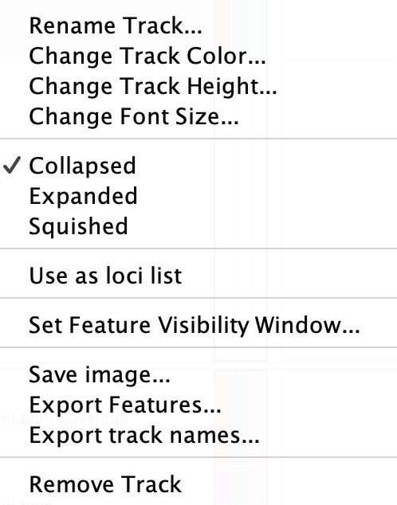
Navigating the IGV UI
1. Changing track height, track color and font size
This is an option available in the pop-menu bar in the tracks.
To do this: Right click/Control press in side of the track (where the track name appears -> Change track height/Change track color/Change font size

Slide 20
Navigating the IGV UI
3. Feature Track
RefSeq gene track is available to view by default.
This is how it looks for the entire genome.
But the scale/zoom tool in the tool bar can be used to zoom in to genes in different regions.
Zoomed in gene track:
There are 3 options for viewing these gene tracks. This is helpful when displaying overlapping features like transcripts of a gene.
To change view, right click on feature track and select one of the following options:
Collapsed
Squished
Expanded

Slide 21
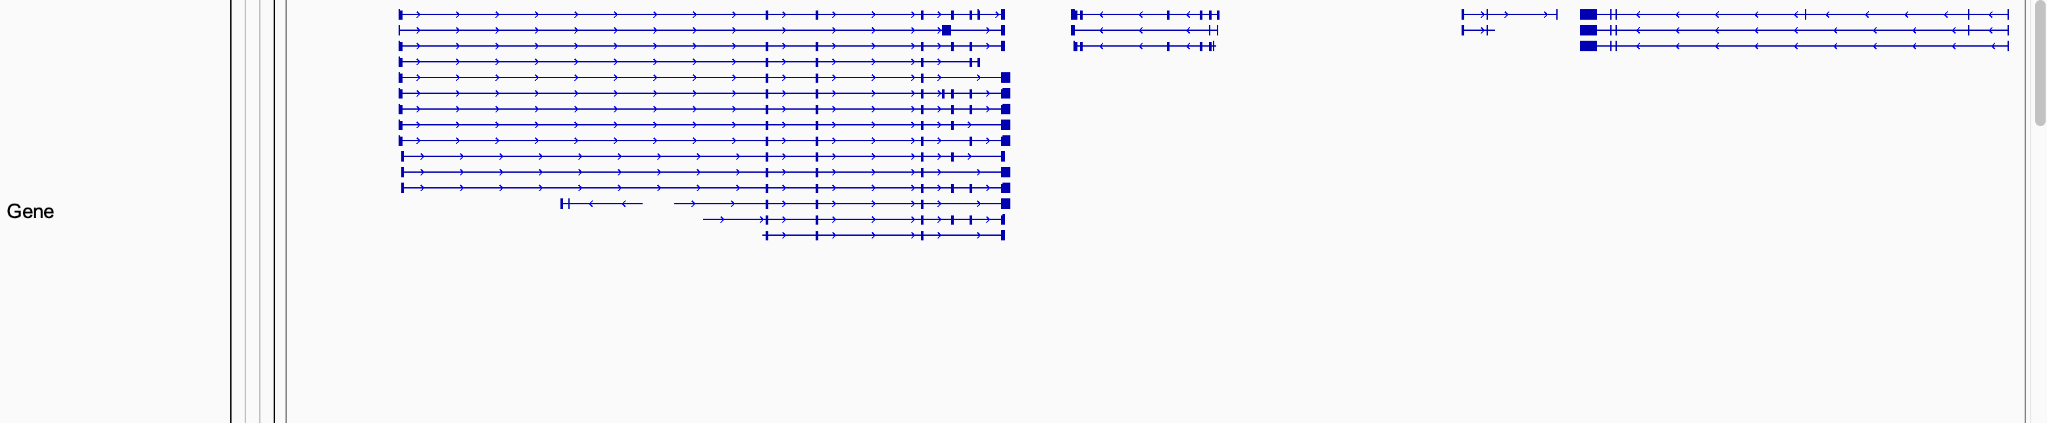
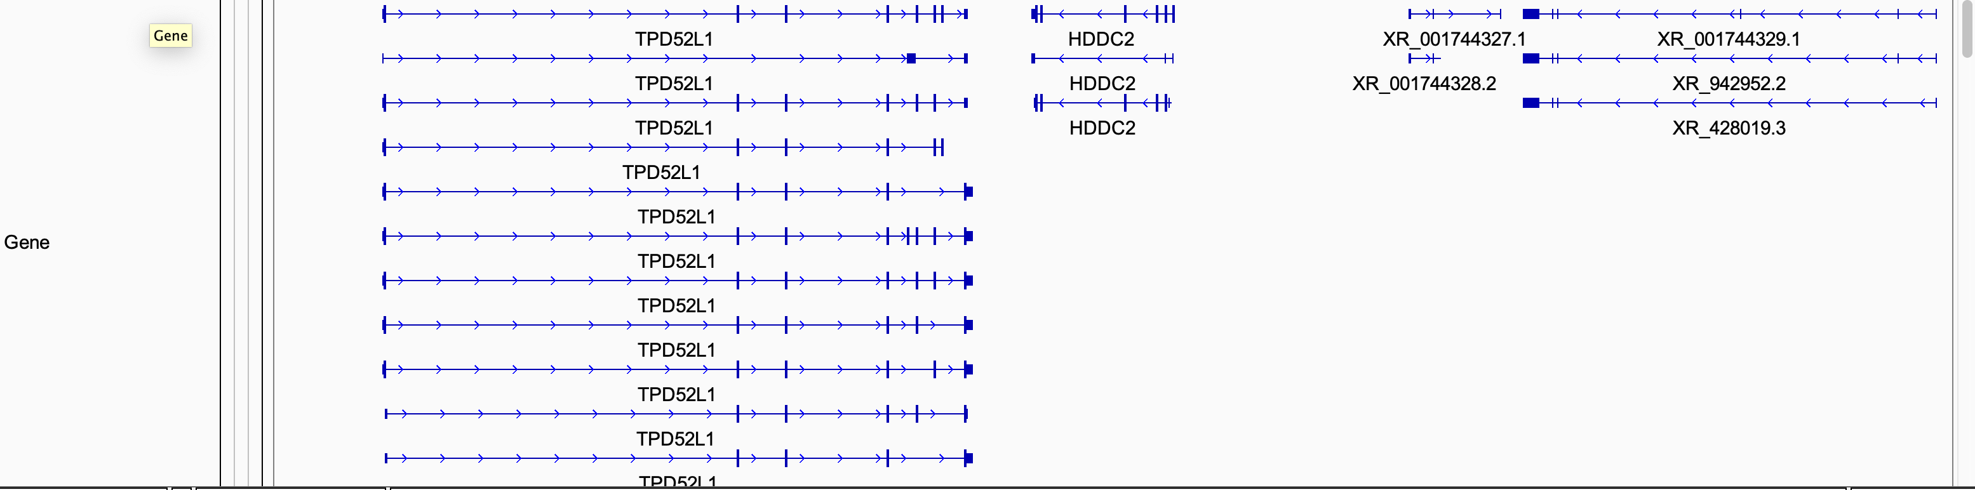
Navigating the IGV UI
3. Feature tracks
Collapsed:
Squished:
Expanded:

Slide 22
Navigating the IGV UI
3. Feature tracks
Expanded:
3’ UTR
(Untranslated Region)
5’ UTR
(Untranslated Region)
Exons
Introns
Direction of arrows (Introns) indicate direction of transcription

Slide 23
Exercise 2 – Load Data
Load the alignment files (aligment.bam) from the day1/data by: File -> Load from File -> day1/data/alignment.bam. (Make sure to have the index files - .bai files in the same directory)
Retain the Genome build as Human (hg38)

Slide 24
Questions
What are we looking at? What do you observe?
What are the similarities/differences between the tracks loaded into IGV?
What is the significance of some tracks aligning to each other and some not?
What do we infer from these visualizations?
What are the conclusions we draw?

Slide 25
What do we see?
5 tracks including the Refseq gene track visualizing 3 different data files
2 tracks of control and experiment bigWigs (.bw) which shows the genome wide signal data – continuous data
One regulatory_sites.bed (Browser Extensible Data) tracks which has the region/coordinate information
One alignment.bam track which is a binarized tab-delimited text file that contains sequence alignment data
An alignment.bamCoverage track that is automatically generated – This shows the depth of coverage/number of reads per bin
Notes:
BamCoverage is particulary useful when there are multiple bam files and to compare the coverage depth or read-depth visually is easier using the coverage track. These are normalized for sequencing depth unlike bam files.
Coverage is calculated from the number of reads per bin across the genome

Slide 26
Observations and Significance
There are signal intensity peaks at regions of the control and experiment .bws. Some of them align and some do not
This can be used to draw out the differences between the 2 samples (differential expression/differential accessibility/differential regulation)
The regulatory_sites.bed shows regions for some of the signal intensities in the control and experiment.bw
There is differential regulatory activity at those regions/sites but not others
There are genes aligned or in near proximity of the regulatory_sites.bed
The regulatory regions may be modulating expression of that gene
Visualizing the positions of these regions in the genome may also indicate its functionality like a Transcription Factor Binding Site or Promoter
Notes:
Regulatory regions of a chromosome controls gene expression. Eventhough the DNA is the same in most of our cells, it’s gene regulation that is responsible for each cell having different set of active genes.
Identifying such regulatory regions in the genome (outside of already know promoters, enhancers or silencers) gives us power to learn and understand how these might affect gene expression of nearby genes. Experiments can be designed around such regions to study how gene expression changes if we target such regions. One example of such regions can be TFBS (Transcription Factor Binding Sites). TFs bind to gene promoters or distal regions called enhancer and thereby regulate gene expression.

Slide 27
Key Takeaways:
IGV is a powerful visualization tool
Can be used to visualize experimental data, QC on the quality of the data
Can compare expected versus observed results and whether it makes sense from the experiment point of view
Can act as a first pass at analyzing data in hand visually (before using any computational tools) to either benchmark or set expected outcomes

Slide 28
UCSC Genome Browser
The University of California Santa Cruz (UCSC) Genome Bioinformatics website consists of a suite of free, open-source, on-line tools that can be used to browse, analyze, and query genomic data
The website provides a quick and easy-to-use visual display of genomic data
A few among the suite of tools available in UCSC are:
BLAT – Pairwise sequence alignment
LiftOver – Converts genomic coordinates and annotations between assemblies
Variant Annotation Integrator – Add functional annotations to variant calls
Can download data – genomic annotations, sequence files, alignments + data from tracks/browser – Table browser

Slide 29
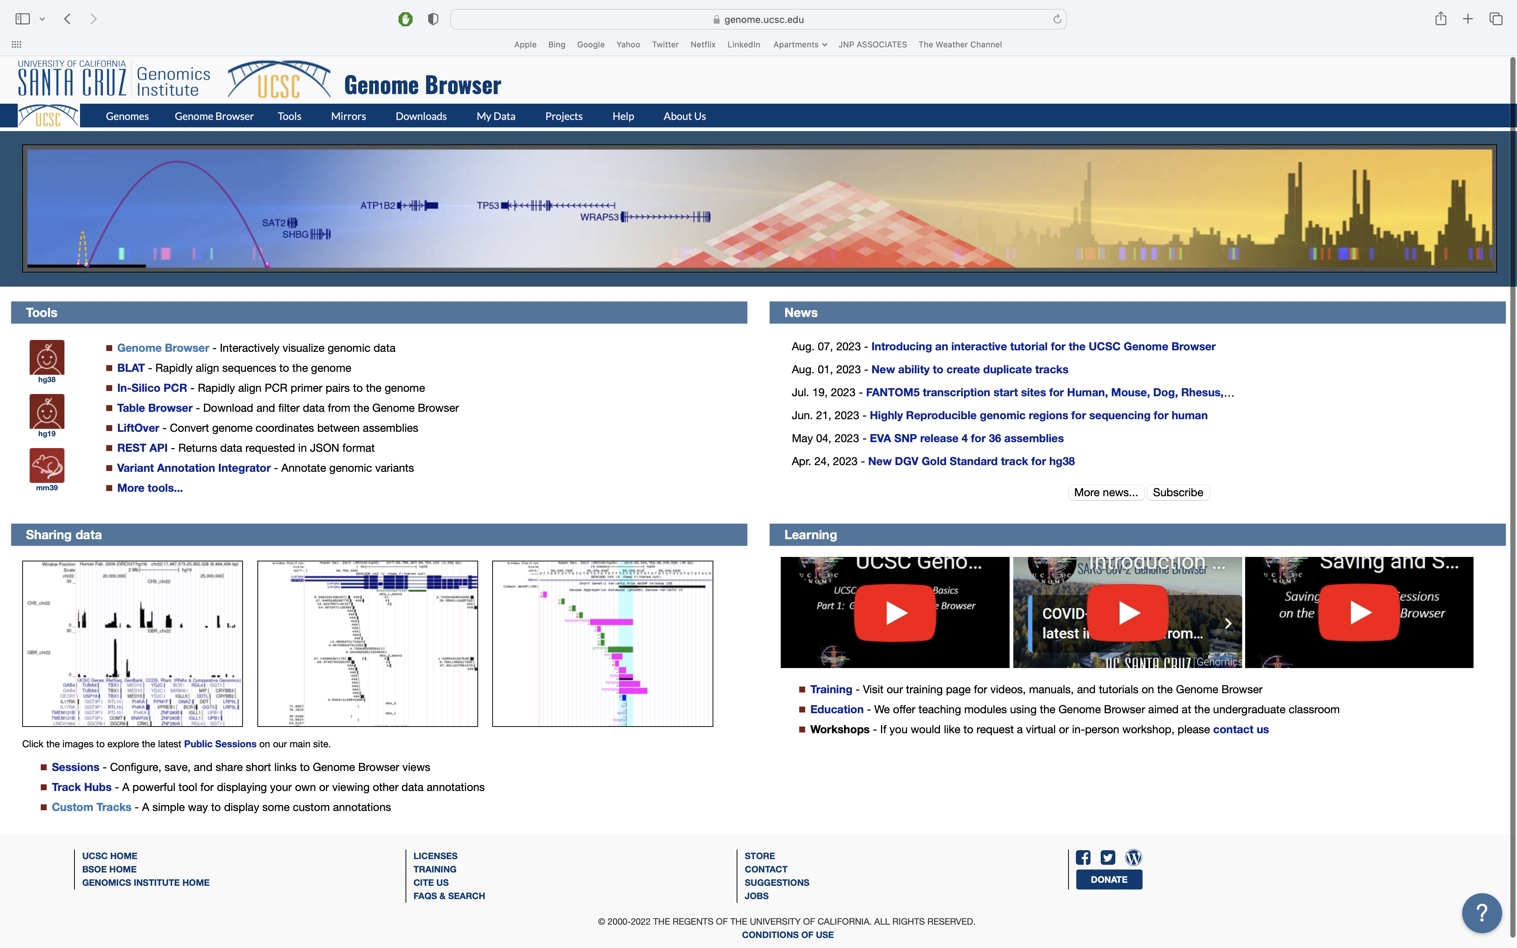
Open the University of California Santa Cruz genome browser website: https://genome.ucsc.edu/

Slide 30
Click on ‘Genomes’

Slide 31
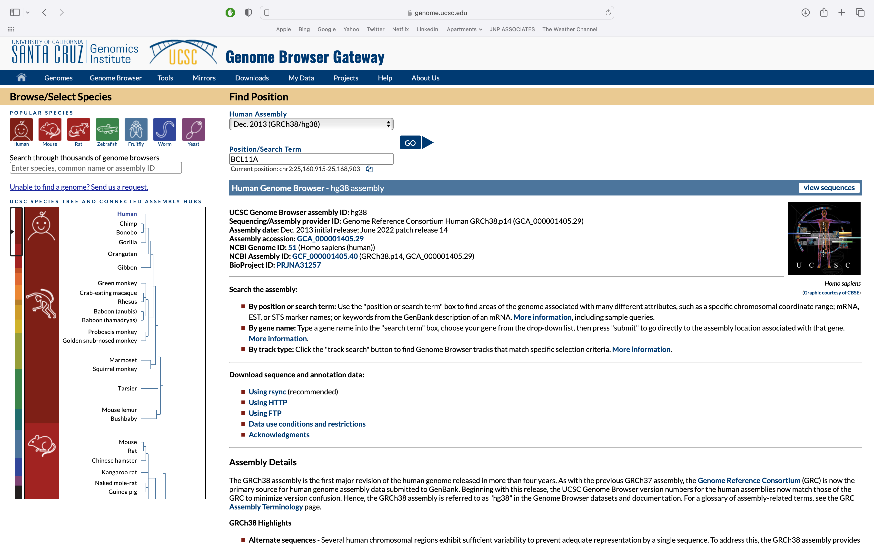
Use the hg38 assembly (ie version) of the human genome and enter BCL11A as the search term

Slide 32
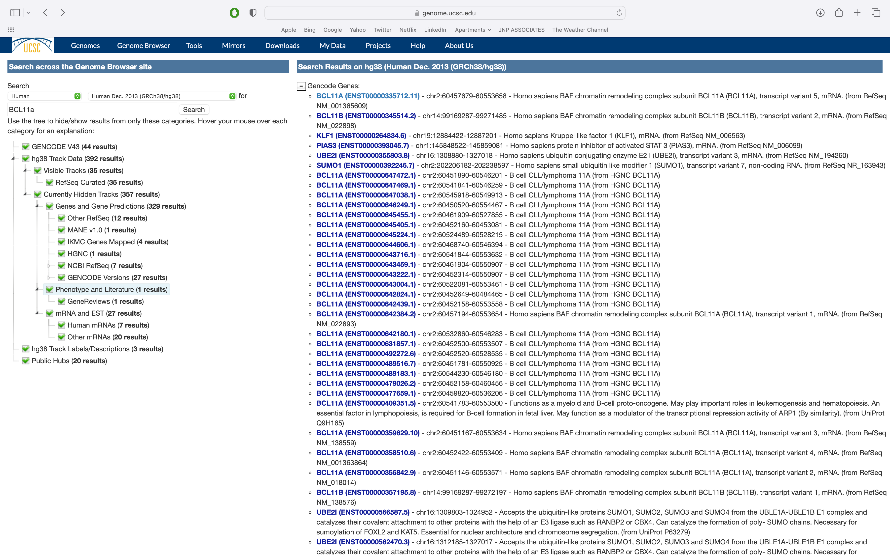
If your query has multiple matches be sure to select the correct one

Slide 33
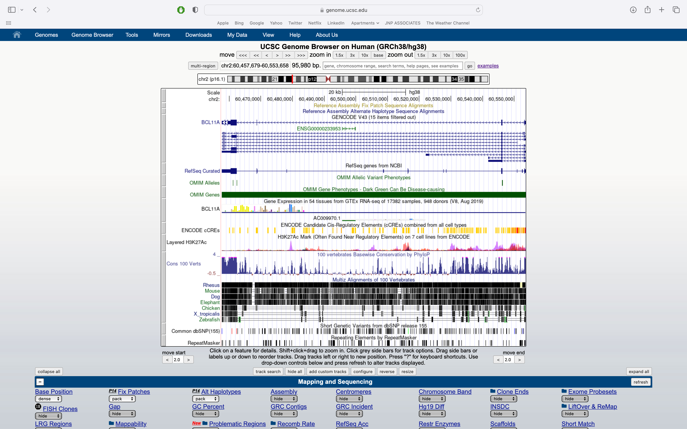
The default view of the BCL11A gene in the UCSC genome browser

Slide 34
The default view of the BCL11A gene in the UCSC genome browser
TOOLBAR
NAVIGATION CONTROLS
VIEW OF GENOMIC FEATURES
DISPLAY CONTROLS

Slide 35
The default view of the BCL11A gene in the UCSC genome browser
Each grey bar is a ‘track’.
The title of each track is centered in the browser.
Tracks are controlled below the browser.

Slide 36
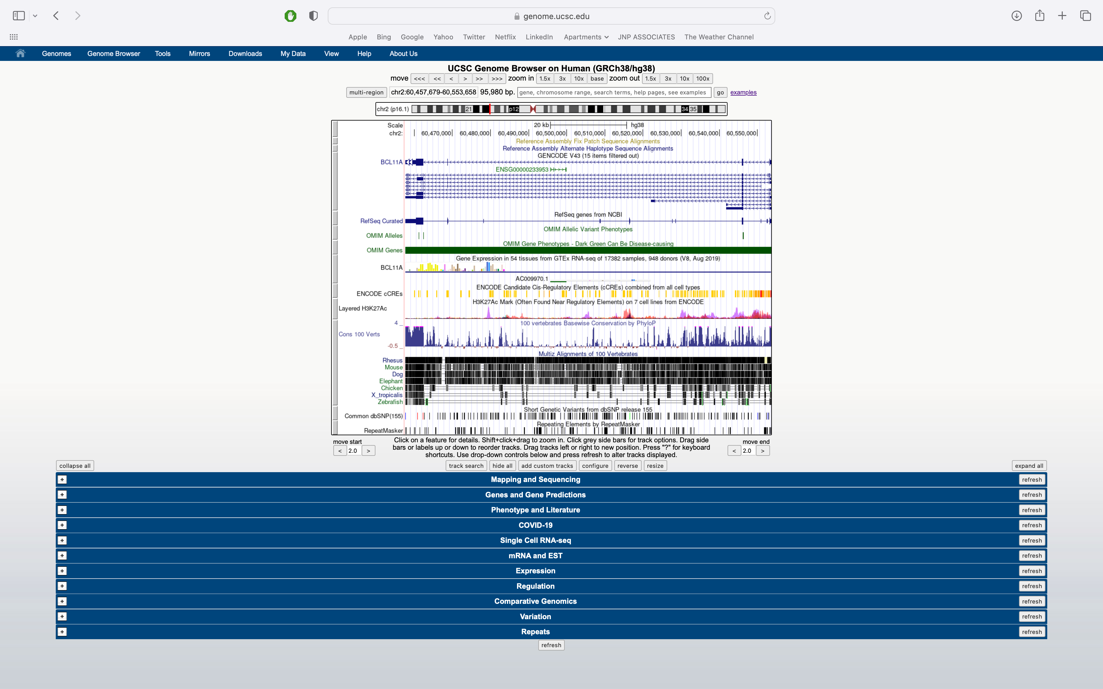
The full page
Each of the drop down menus(blue bars) allows for customizable visualization of tracks.
Data & annotations
Many options
Updates and new tracks occur semi-frequently

Slide 37
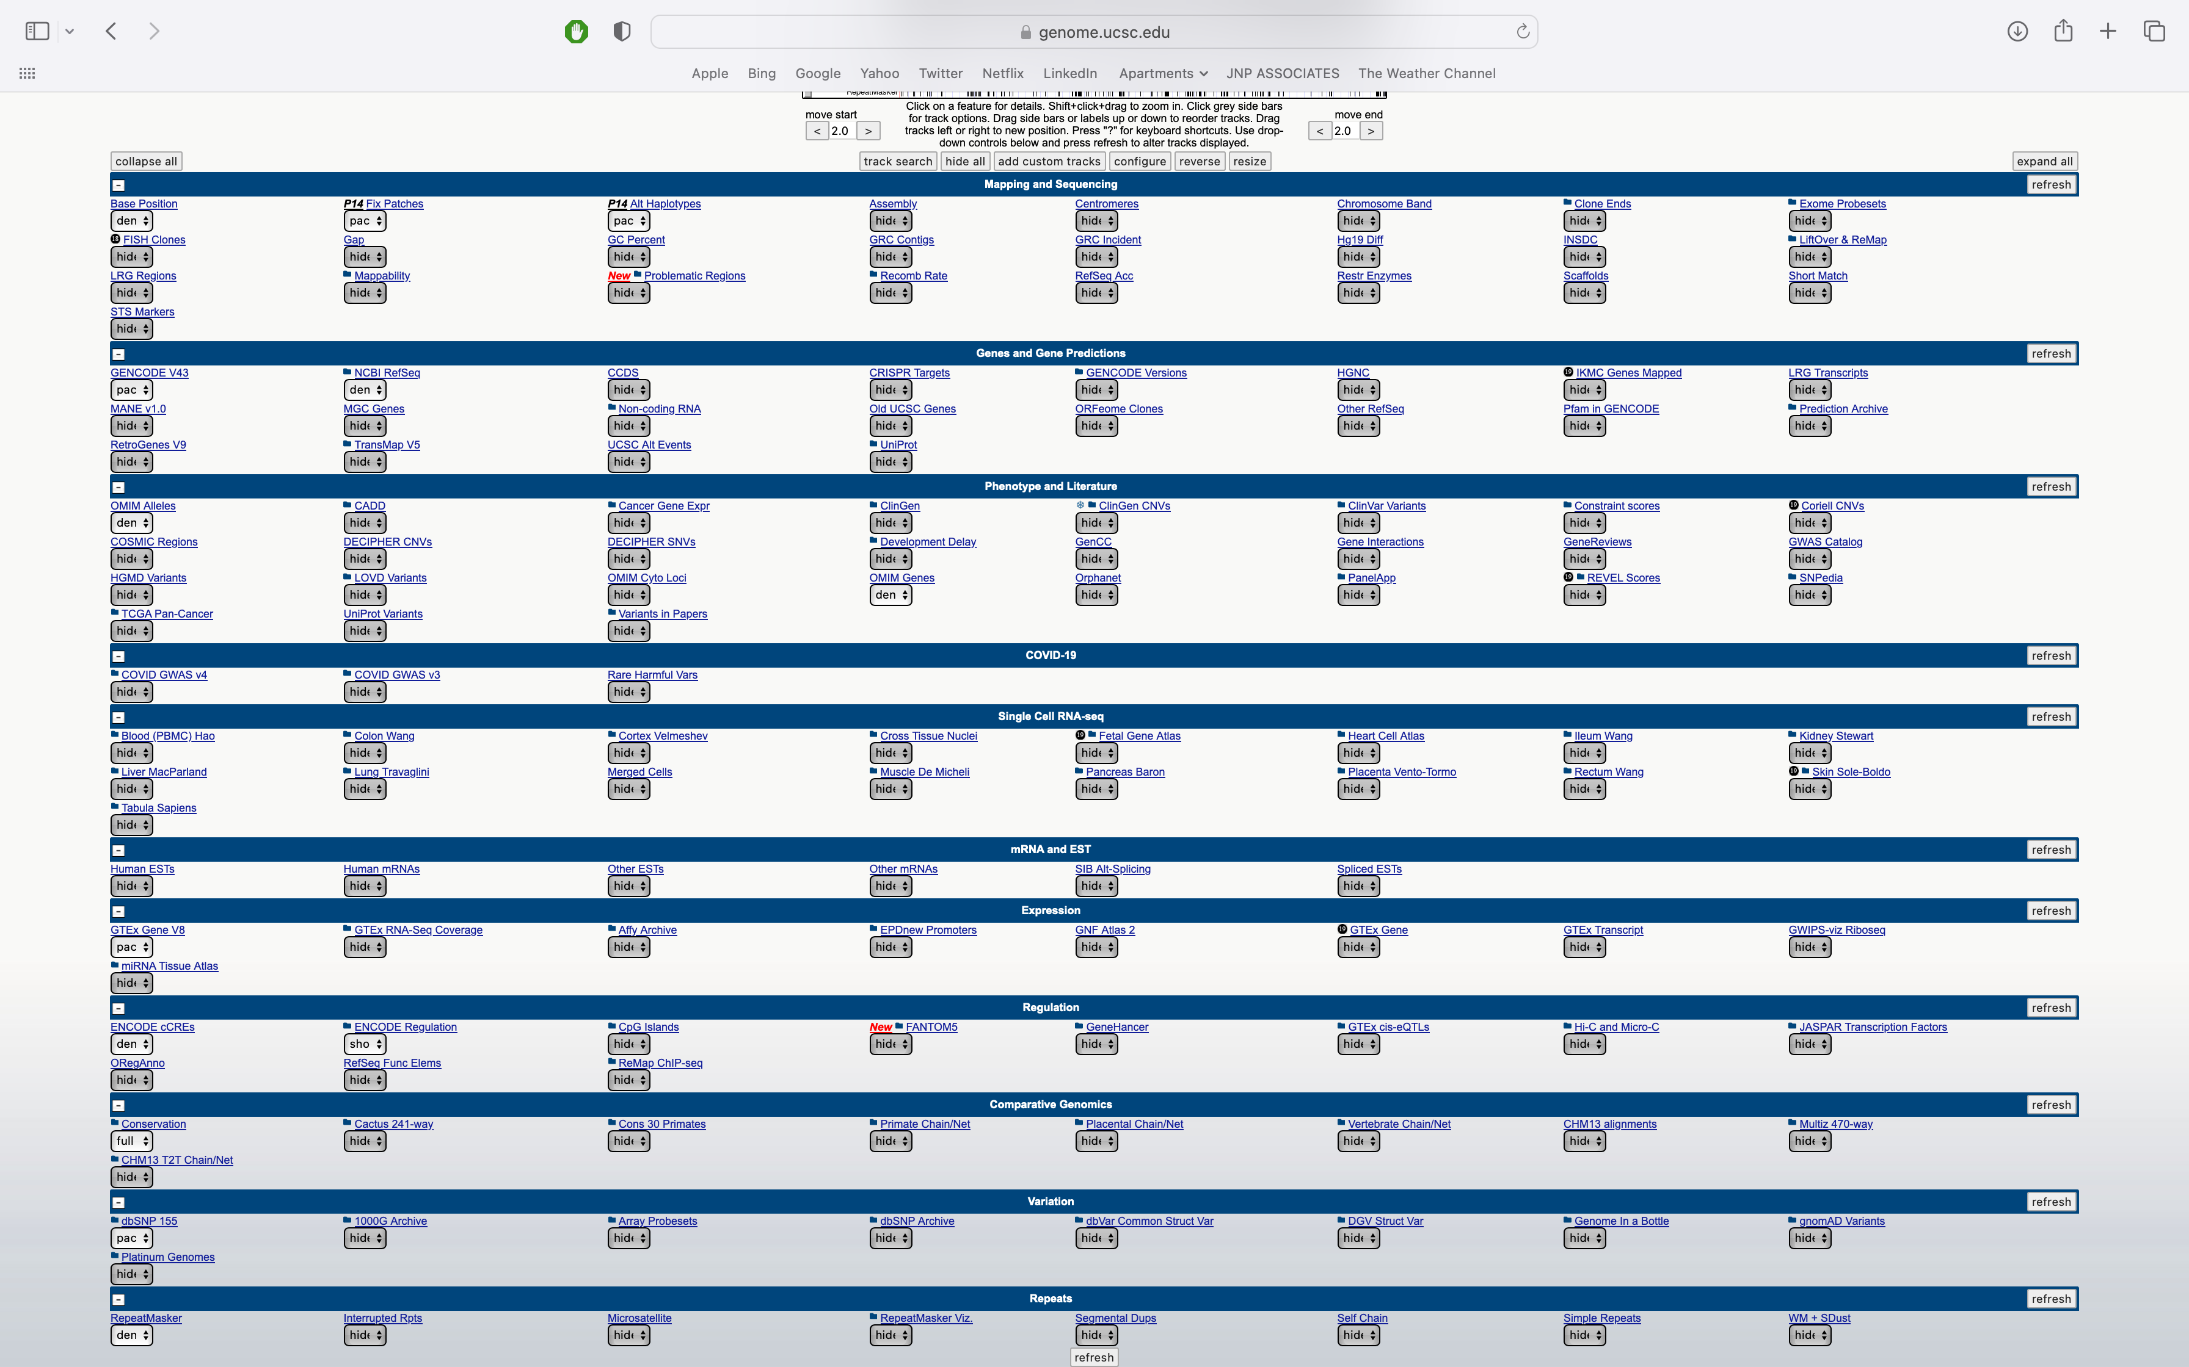
The full page – drop downs expanded

Slide 38
The full page – drop downs expanded
Each of the drop down menus(blue bars) allows for customizable visualization of tracks.
Data & annotations
Many options
Updates and new tracks occur semi-frequently

Slide 39
Acknowledgements
Dr. Tim Reddy
Dr. Alex Ochoa
Shannon Clarke
Dr. Opeyemi Olabisi
Dr. Bill Majoros
Dr. Rasheed Gbadegesin
Dr. Allison Ashley-Koch
Dr. Andrew Allen
Apoorva lyengar
Makenzie Beaman
Yuncheng Duan
Eden Harris
Ama Antwi
Duke PRIME-PREP Program

Slide 40
Thank You!!

Slide 41
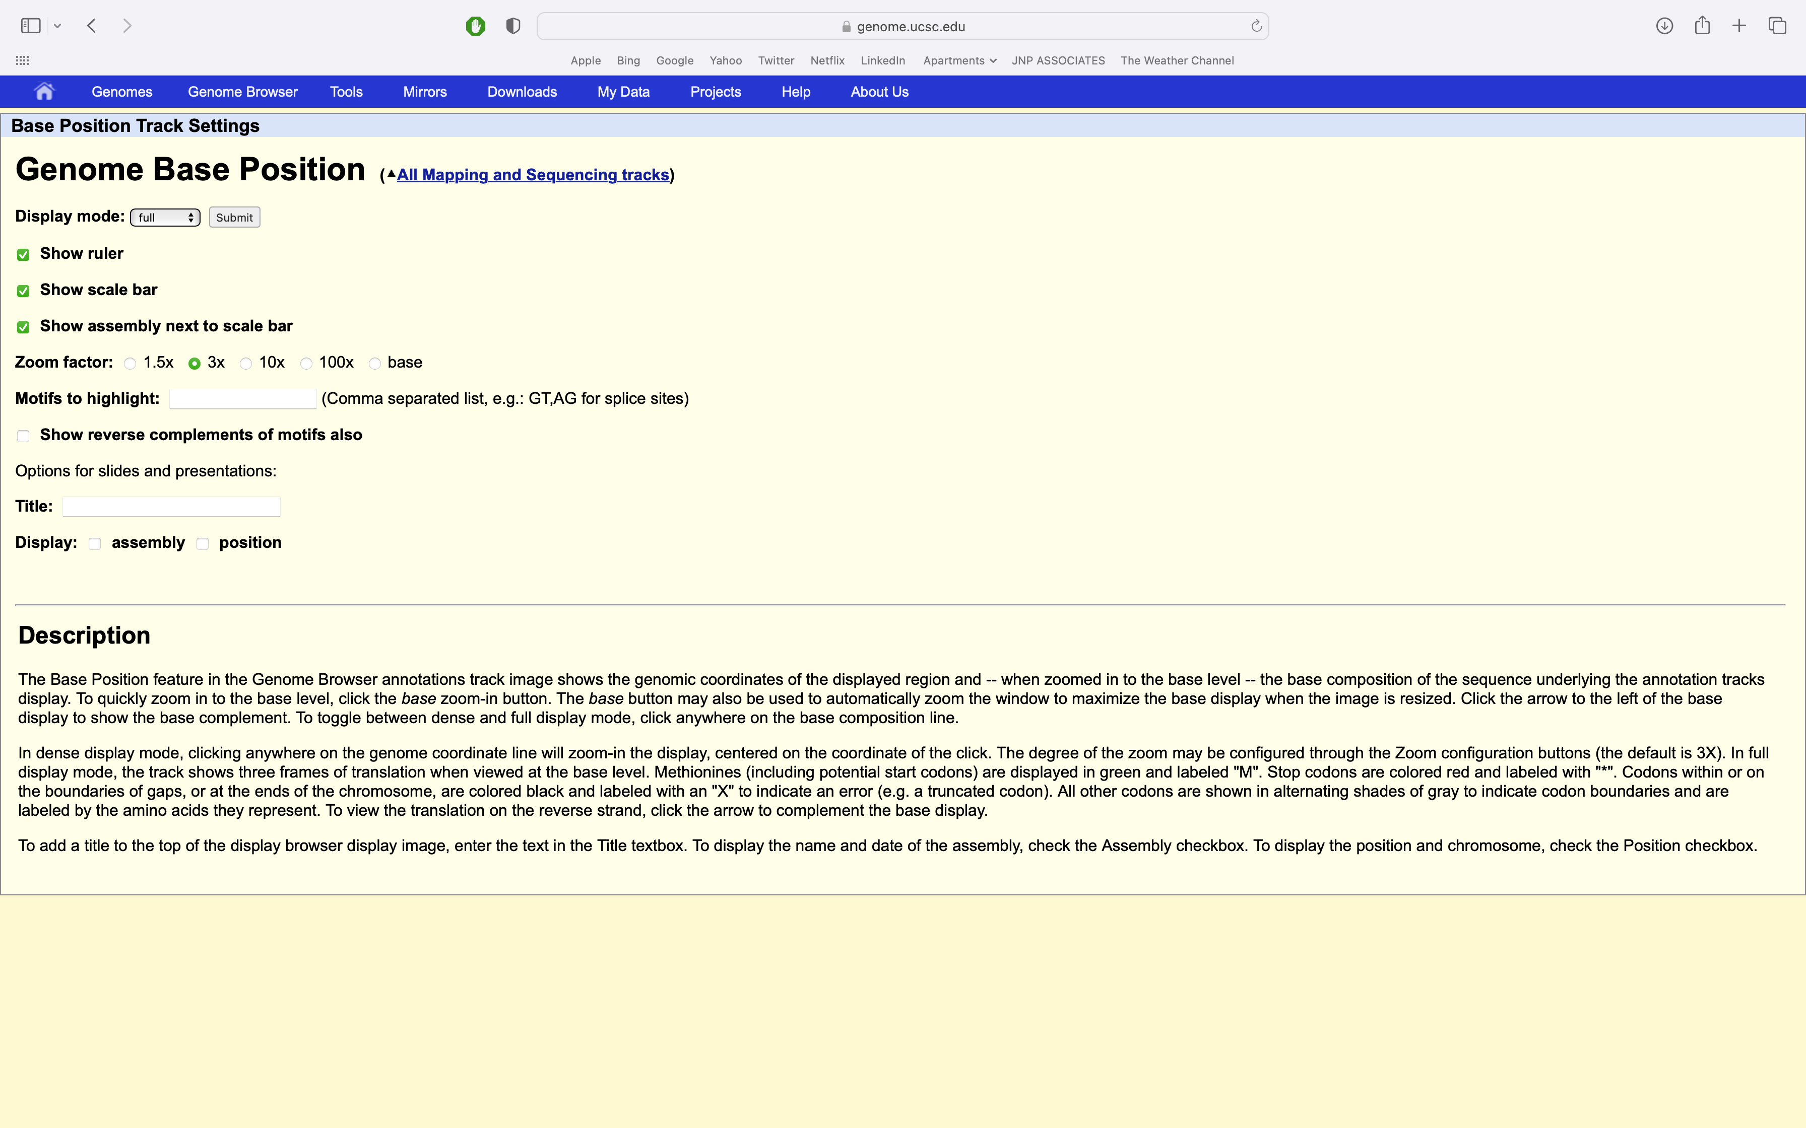
Genomic base position – detail page

Slide 42
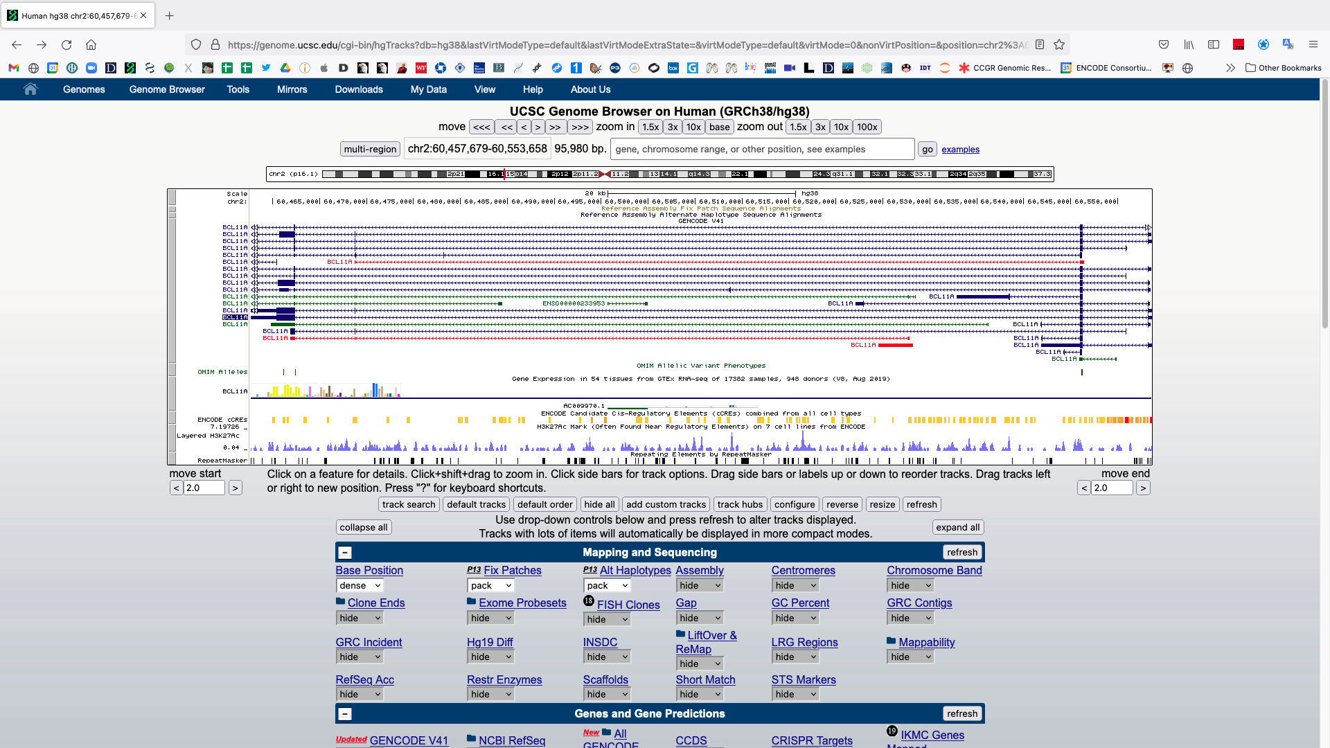
The default view of the BCL11A gene in the UCSC genome browser
Different gene models/isoforms
Most common isoform

Slide 43
Zoom out
Click here

Slide 44
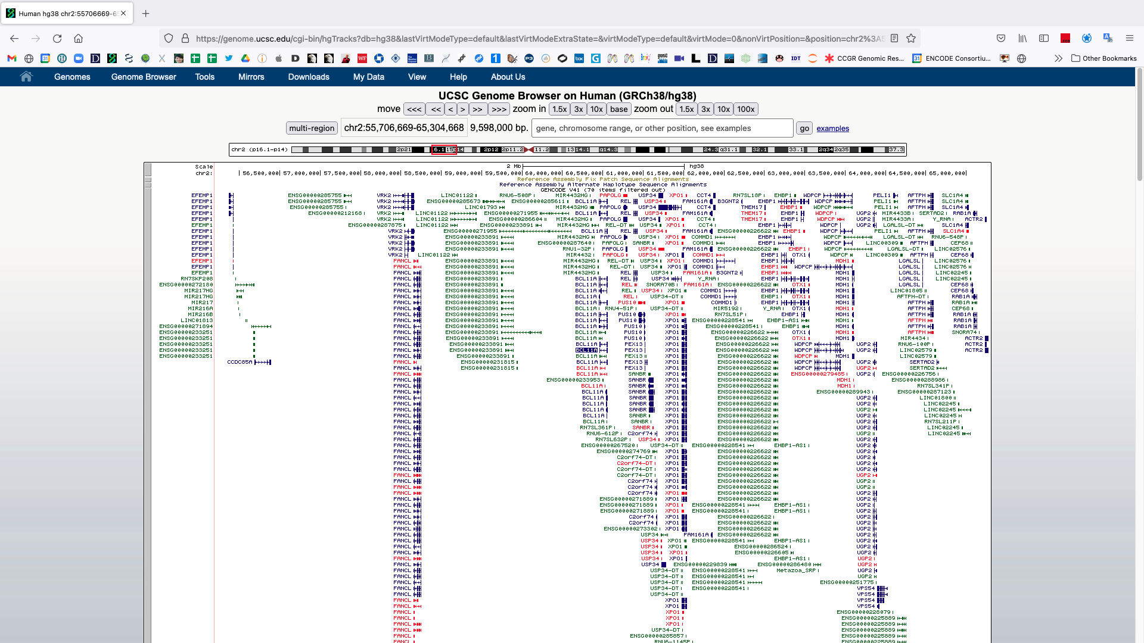
Many more genes can be observed when zoomed out

Slide 45
You can zoom in and out from 1 bp to a whole chromosome
Type in chr2:55,706,669 and hit ‘go’

Slide 46
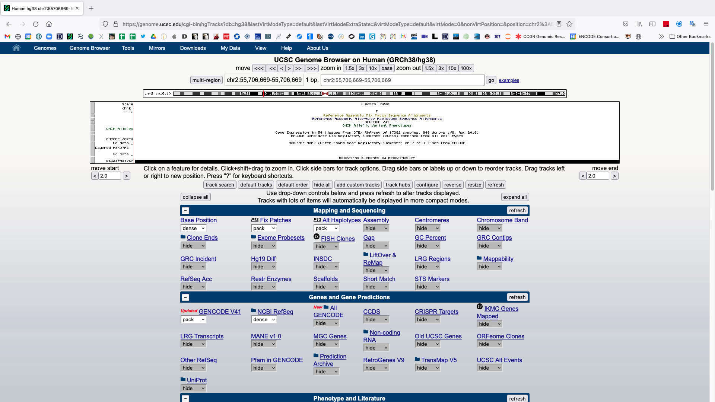
Single base
Notice how a one base pair coordinate position is represented
chr2 = chromosome 2
55,706,669 = this base is the 55,706,669th base on chr2
A single base pair (thymine)

Slide 47
Zoom out to three bases
Click here

Slide 48
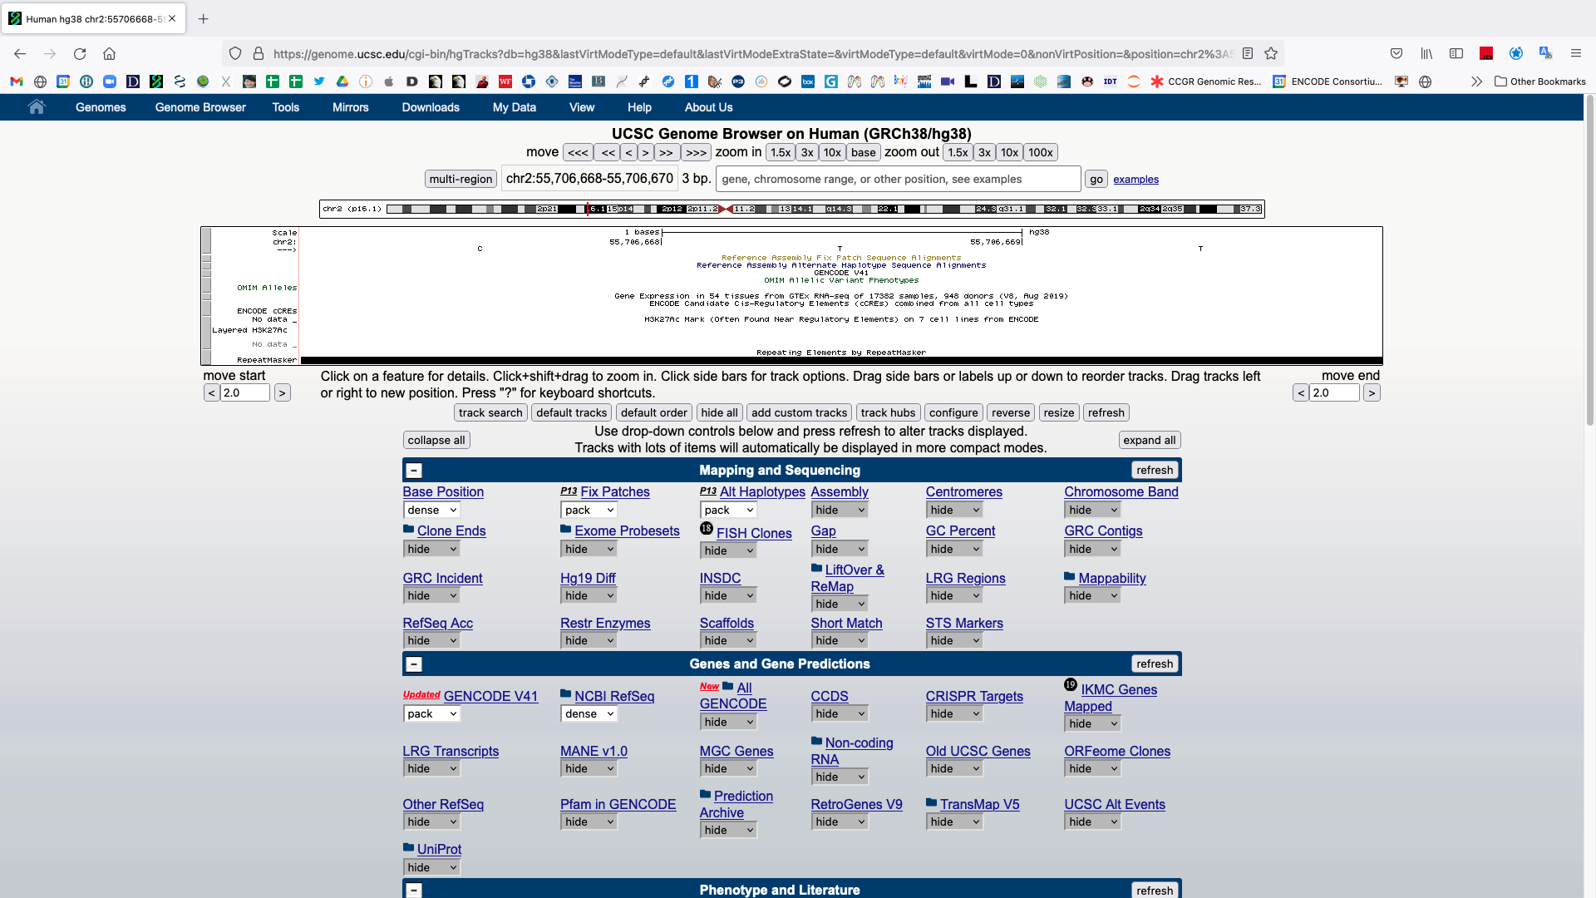
Notice how a coordinate position > 1 base pair (bp) is represented.
cytosine, thymine, thymine

Slide 49
Zoom out
Type in chr2 and hit ‘go’

Slide 50
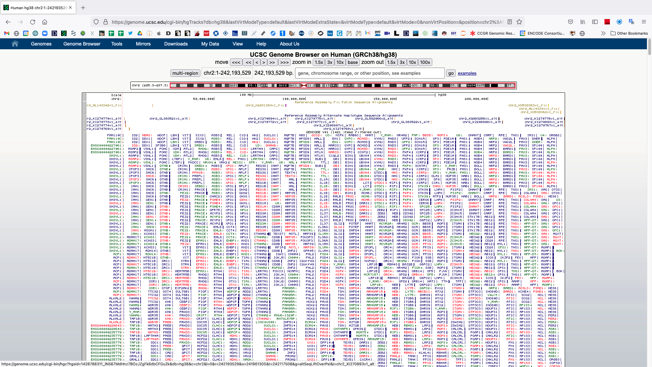
Chromosome 2
Notice the red box around the entire chromosome 2 ideogram
Too much information is being shown.
All known models for all genes on chr2.

Slide 51
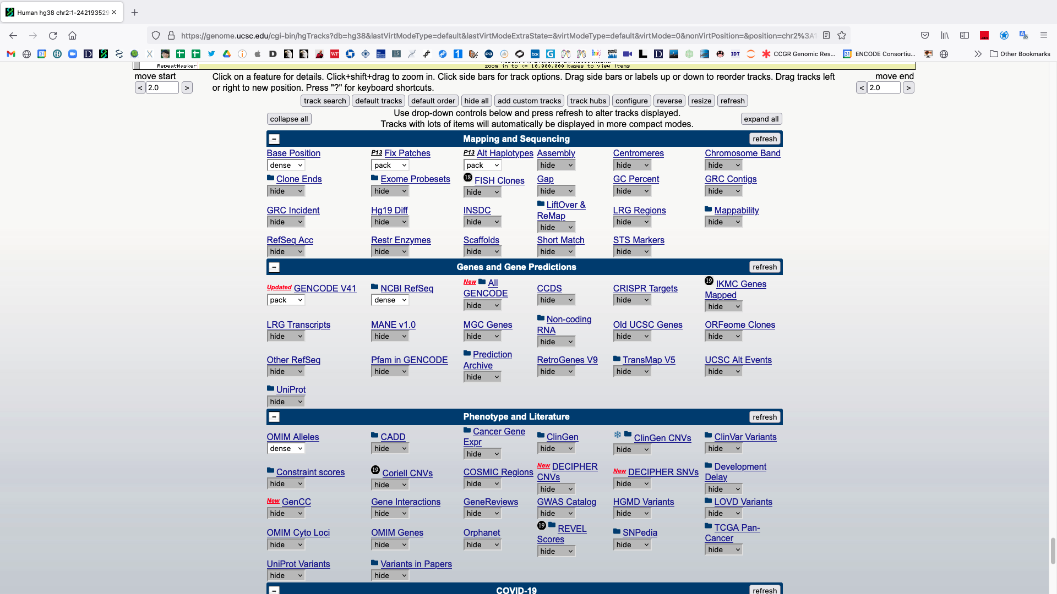
Adjust some settings
Scroll down and make the following changes:
GENCODE → squish
NCBI RefSeq → hide
OMIM Alleles → hide
GTEx Gene V8 → hide
Scroll down to find
After making the changes hit any ‘refresh’ button.

Slide 52
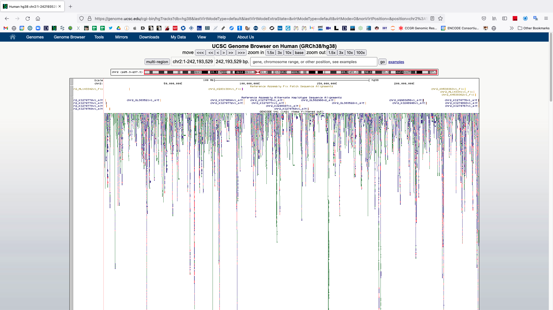
The gene models have been collapsed and other tracks removed (scroll down)

Slide 53
Tracks can be further modified by clicking on the grey bars to the left
Click on the GENCODE grey track bar

Slide 54
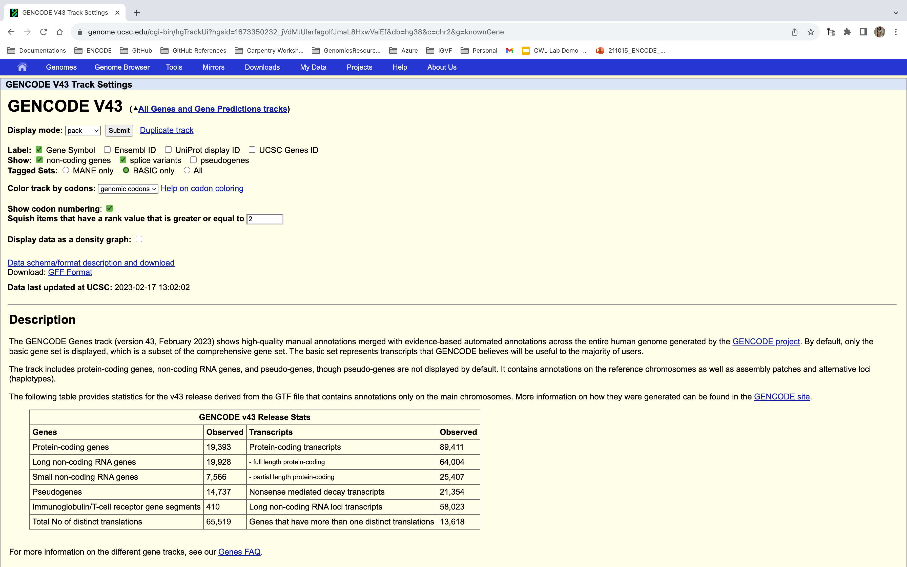
Track settings for the GENCODE track. These pages vary by track.

Slide 55
Change some options to hide data.
Click on “non-coding genes” and “splice variants” to hide the representation of these annotations.
Data visualization involves choices which impact interpretation, both yours and that of your audience.
Hiding these options can make interpreting data in a broad genome browser region more interpretable but removes information.
Hit ‘submit’ to see the changes.

Slide 56
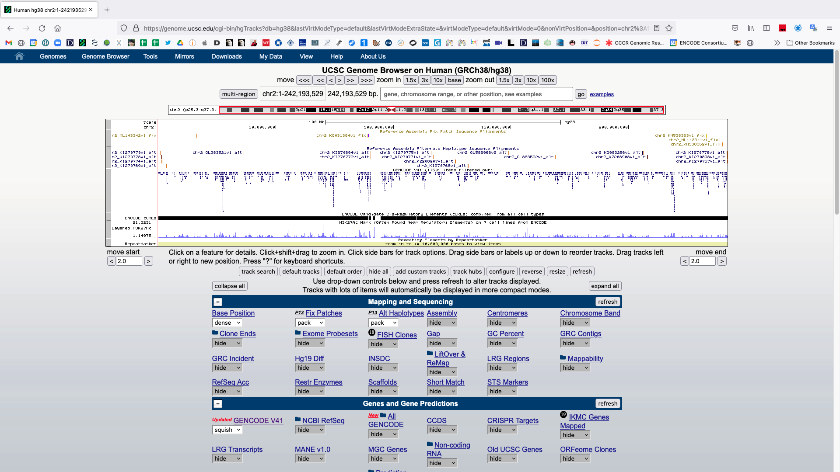
Now only a single model is shown for each gene. Return to BCL11A.
Type in BCL11A and hit ‘go’

Slide 57
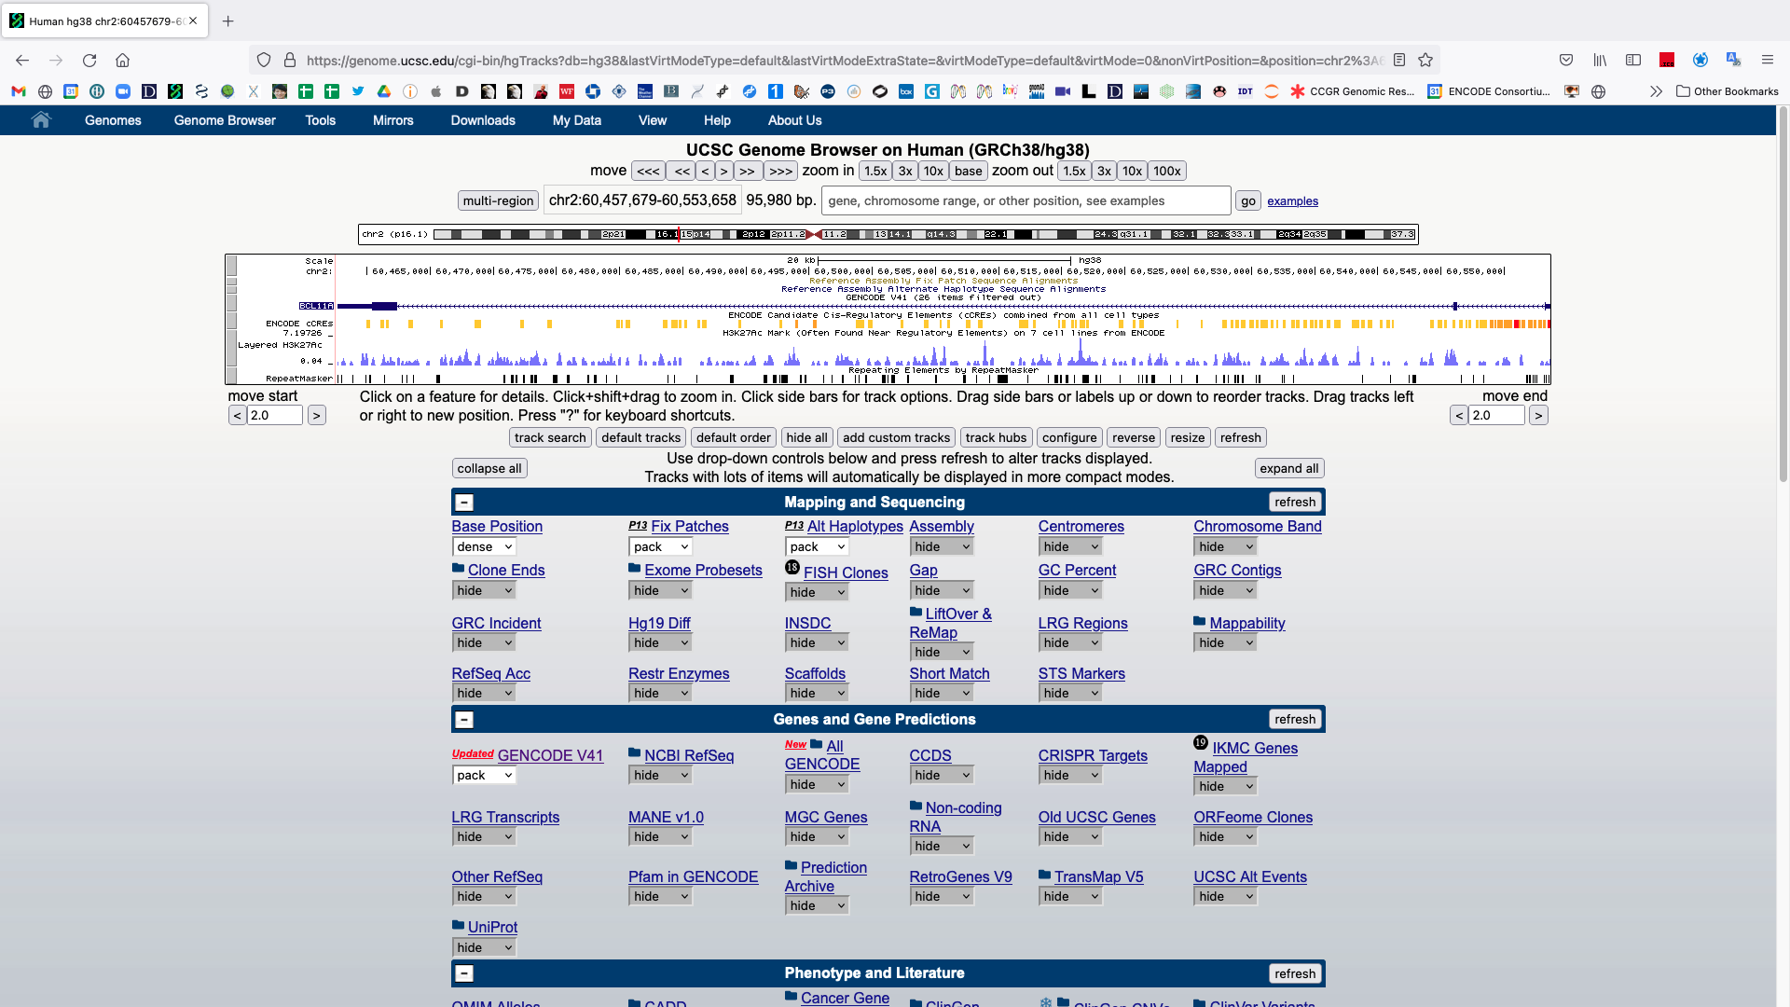
BCL11A & gene structure.

Slide 58
BCL11A & gene structure.
Notice the BCL11A’s position on chromosome 2
Ideogram (red vertical line)
chr:start-end coordinate
Exons are boxes
5' and 3' untranslated regions (UTRs) are thinner boxes
Introns are lines with arrowheads pointing in the direction of transcription

Slide 59
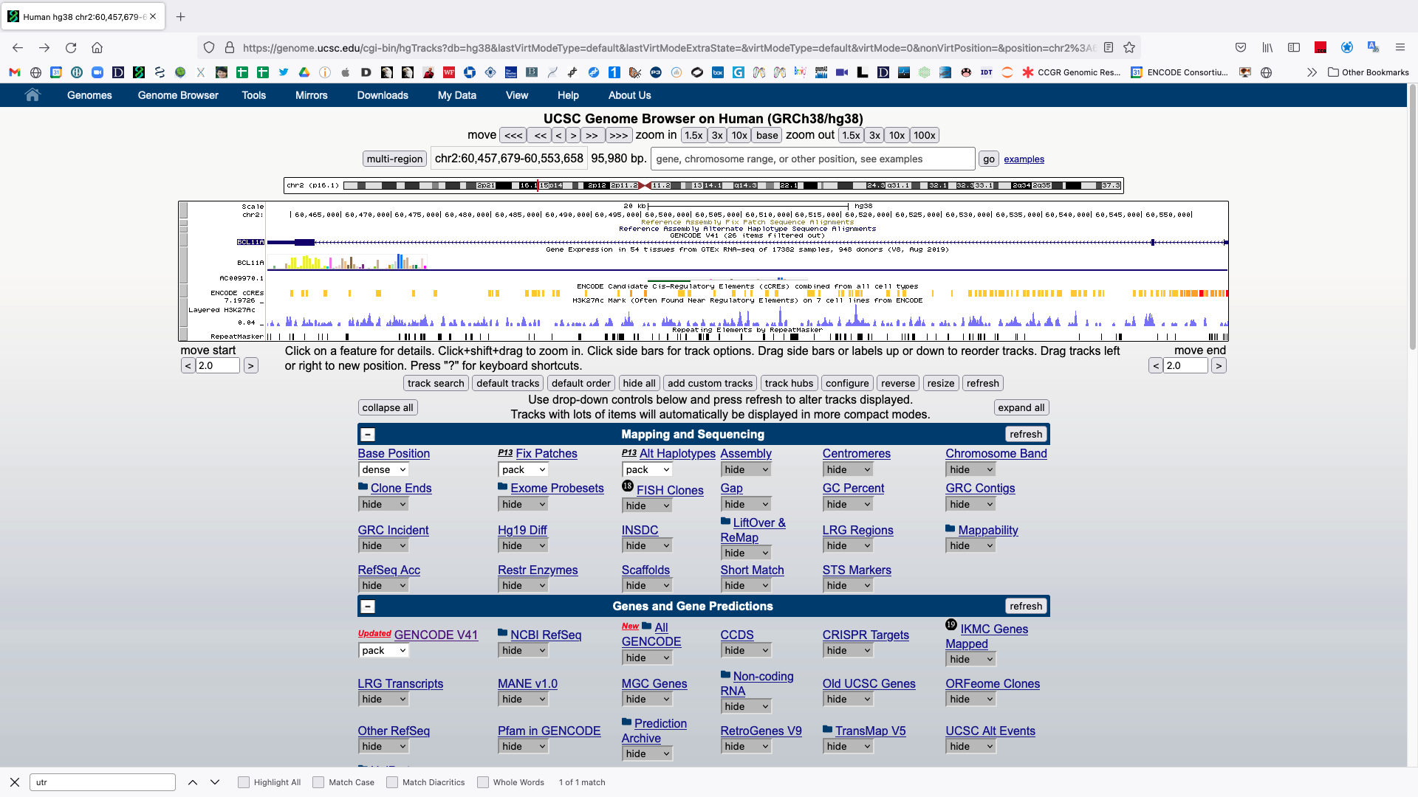
Scroll down and change the GTEX setting to ‘full’ and hit ‘refresh’.
Click the plot after refreshing
Change GTEx setting to “full”

Slide 60
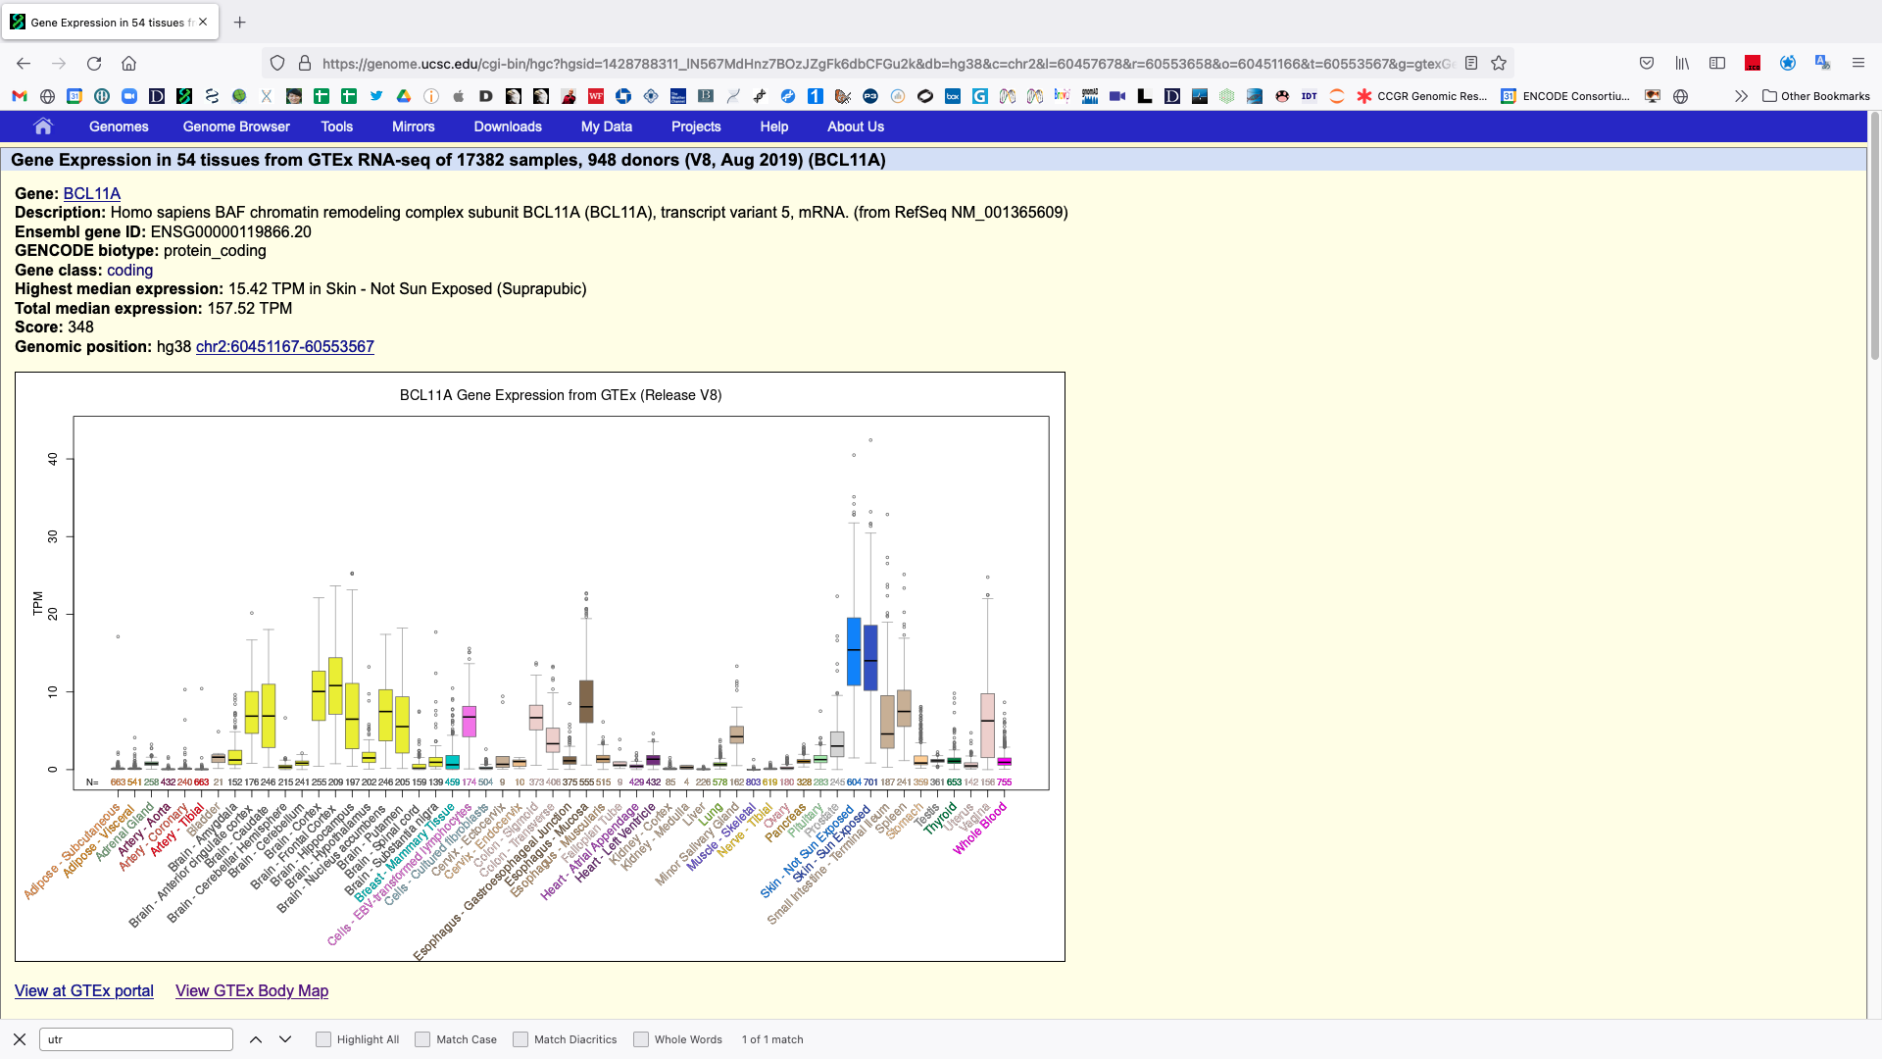
Primary tissue gene expression results from GTEX
TPM (Transcripts Per Million) is the most common unit for describing the abundance of a transcript.
Describes the amount relative to all other observed transcripts.

